Slide 1
CHAPTER THREE
LEARNING AND THEORIES OF LEARNING

Slide 2
3.1. Definition, Characteristics and Principles of Learning
3.1.1. Definitions of learning
Learning is a relatively permanent change in behavior occurring as a result of experience or practice.
The above definition emphasizes four attributes of learning: -Learning is a change in behavior.
-This change in behavior is relatively permanent -This change in behavior is because of experience, or practice - The learning is not directly observable but manifests in the activities of the individual

Slide 3
3.1.2. Characteristics of learning
Learning is continuous modification of behavior throughout life.
Learning is pervasive, it reaches into all aspects of human life.
Learning involves the whole person, socially, emotionally & intellectually.
Learning is often a change in the organization of experiences.
Learning is responsive to incentives.
Learning is an active process.
Learning is purposeful.
Learning depends on maturation, motivation and practice.
Learning is multifaceted.

Slide 4
3.1.3. Principles of learning
Individuals learn best;
When they are physically, mentally, & emotionally ready.
When they have meaningful practice and exercise, and
When it is accompanied by a pleasant or satisfying feeling
Things learned first create a strong unforgettable impression.
Things most recently learned are best remembered.
The principle of intensity implies that a student will learn more from the real thing than from a substitute.
Some abilities and skills that may help individuals to learn.
Things freely learned are best learned - higher intellectual and moral advancement occur when learning is through freedom.

Slide 5
3.2. Factors Influencing Learning
Motivation
Maturation
Health condition of the learner
Psychological wellbeing of the learner
Good learning conditions
Background experiences
Length of the working period
Massed and distributed learning Do learning materials, teaching styles, teaching methods, and medium of instruction affects learning like the factors listed above? Why?

Slide 6
3.3. Theories of Learning and their Applications
1. Behavioral Theory of Learning
Behavioral theory of learning believes that learning occurs as a result of stimulus-response associations.
Behavioral theories emphasize on observable behaviors, seek laws to govern all organisms, and provide explanations which focus on consequences.
There are two major behavioral theories of learning. They are known as classical and operant conditioning.

Slide 7
1 A. Pavlov’s Classical conditioning theory
It is sometimes called learning through association.
Classical conditioning focuses on the learning of making involuntary emotional or physiological responses to stimuli that normally elicit no response. E.g., fear, increased heartbeat, salivation or sweating at the sight of a hyena.
Through the process of classical conditioning, humans and animals can be trained to act involuntarily to a stimulus that previously had no effect - or a very different effect - on them.
Classical conditioning involves conditioned reflexes. E.g., the production of saliva (conditioned reflex) in a response to food.
In short, classical conditioning (sometimes called substitution learning ) is a type of learning in which a neutral stimulus comes to bring about a response after it is paired with a stimulus that naturally brings about that response.

Slide 8
Basics of Classical Condition
To demonstrate classical conditioning, we must first identify stimuli and responses.
Neutral stimulus: A stimulus that, before conditioning, does not naturally bring about the response of interest.
Unconditioned stimulus (UCS): A stimulus that naturally brings a particular response without having been learned.
Unconditioned response (UCR): A response that is natural and needs no training (e.g., salivation at the smell of food).
Conditioned stimulus (CS): A once neutral stimulus that has been paired with an UCS to bring about a response formerly caused only by the UCS.
Conditioned response (CR): A response to the CS.

Slide 9
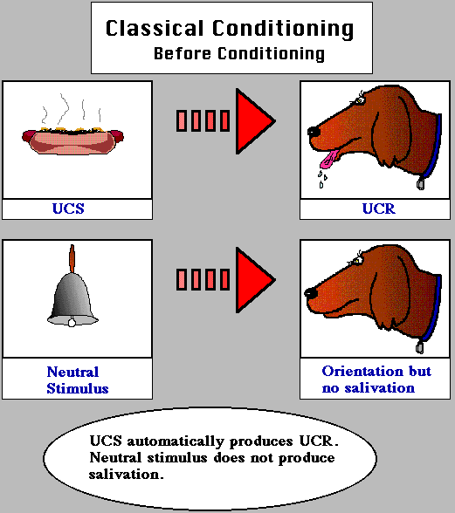
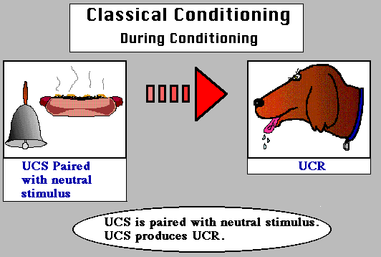
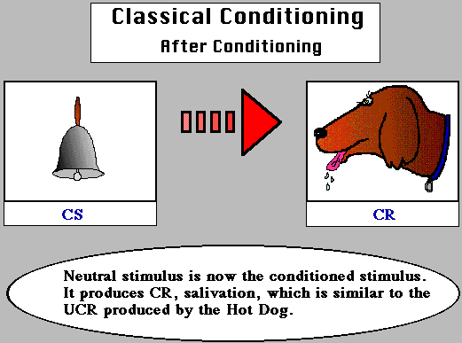
Pavlov’s classical conditioning experiment
Food (UCS) → Saliva (UCR)
Bell (neutral stimulus) → No saliva
Food(UCS)+Bell(NS)→Saliva(UCR)
Bell (CS) → Salivation (CR)

Slide 10
Principles of Classical Condition
A. Stimulus generalization is a process in which stimuli that are similar to the original stimulus begin to produce the same responses. For example, a dog conditioned to salivate to a dinner bell (CS) might also salivate to a door bell, a telephone bell.
B. Stimulus discrimination is the ability to differentiate similar stimuli and responding only to a specific stimulus. E.g., the dog salivates only in response to the dinner bell instead of the doorbell or the telephone bell.

Slide 11
…
C. Extinction If a CS is repeatedly presented without presenting the UCS (meat), the CR will diminish and eventually stop occurring. This process is called extinction. But extinction only inhibits the CR, it does not eliminate it.
D. Spontaneous recovery is the reemergence of an extinguished conditioned response after a period of rest and with no further conditioning. For example, if the dog respond to the dinner bell after experience of extinction by salivating.

Slide 12
1 B. Operant/Instrumental conditioning
Operant conditioning also called Instrumental conditioning is learning in which a voluntary response is strengthened or weakened, depending on its consequences.
In operant conditioning, the organism's response operates or produces effects on the environment. These effects, in turn, influence, whether the response will occur again.
Unlike in classical conditioning, operant conditioning applies to voluntary responses, in which an organism performs deliberately to produce a desirable outcome.

Slide 13
…
According to Skinner, a response (operant) can lead to three types of consequences: (a) Neutral consequence (b) Reinforcement or (c) Punishment.
(a) A neutral Consequence that does not alter the response.
(b) A reinforcement strengthens the response. A reinforcer is any event that increases the re-occurance of a behaviour.
There are two basic types of reinforcers.
Primary reinforcers: Food, water, light, stroking of the skin, and a comfortable air temperature are naturally reinforcing because they satisfy biological needs. Primary reinforcers have the ability to strengthen a behavior without prior learning.
Secondary reinforcers: They reinforce behavior because of their prior association with primary reinforcing stimuli. Money, praise, applause, good grades, awards, and gold stars are common secondary reinforcers.

Slide 14
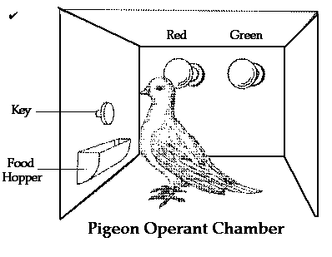
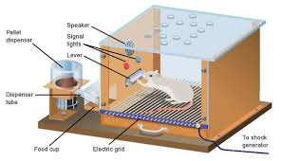
.

Slide 15
Positive and Negative reinforcement
Both primary and secondary reinforcers can be positive or negative.
Positive reinforcement is the process whereby presentation of a stimulus makes behavior more likely to occur again.
Negative reinforcement is the process whereby termination of an aversive stimulus makes behavior more likely to occur. The basic principle of negative reinforcement is that eliminating something aversive can itself be a reinforcer or a reward.
For example, if someone nags you all the time to study, but stops nagging when you comply, your studying is likely to increase- because you will then avoid the nagging.

Slide 16
Negative reinforcement involves escape & avoidance learning.
In Escape learning animals learn to make a response that terminates/stops a noxious, painful or unpleasant stimulus.
In Avoidance Learning, which refers to learning to avoid a painful, noxious stimulus prior to exposure.
Schedules of reinforcement
When a response is first acquired, learning is usually most rapid if the response is reinforced each time it occurs. This procedure is called continuous reinforcement.
However, once a response has become reliable, it will be more resistant to extinction if it is rewarded on an intermittent (partial) schedule of reinforcement, which involves reinforcing only some responses, not all of them.

Slide 17
There are four types of partial/intermittent schedules.
1. Fixed-ratio schedules: Reinforcement occurs after a fixed number of responses. It produce high rate of responding. Employers use fixed ratio schedules to increase productivity.
2. Variable-Ratio Schedule: Reinforcement occurs after some varying number of responses. It produces extremely high steady rates of responding. The responses are more resistant to extinction than when a fixed ratio schedule is used.
3. Fixed Interval Schedule: A fixed interval schedule of reinforcement occurs only if a fixed amount of time has passed since the previous reinforcer.
4. Variable Interval Schedule: A variable interval schedule of reinforcement occurs only if variable amount of time has passed since the previous reinforcer.

Slide 18
..
c) Punishment - is a stimulus that weakens the response or makes it less likely to recur.
Punisher can be any aversive (unpleasant) stimuli that weaken responses or make them unlikely to recur.
Like reinforcers, punishers can also be primary or secondary.
Pain and extreme heat or cold are inherently punishing and are therefore known as primary punishers.
Criticism, demerits, catcalls, scolding, fines, and bad grades are common secondary punishers.

Slide 19
Positive and negative punishment
The positive-negative distinction can also be applied to punishment. Something unpleasant may occur following some behavior (positive punishment), or something pleasant may be removed (negative punishment).
The Pros and Cons of Punishment Immediacy, consistency and intensity matter are important for effectiveness of punishment.
Immediacy – When punishment follows immediately after the behavior to be punished.
Consistency- when punishment is inconsistent the behavior being punished is intermittently reinforced and therefore becomes resistant to extinction.
Intensity- In general terms severe punishments are more effective than mild ones. However, there are studies that indicate that even less intense punishments are effective provided that they are applied immediately and consistently.

Slide 20
When punishment fails?
People often administer punishment inappropriately or mindlessly.
The recipient of punishment often responds with anxiety, fear or rage.
The effectiveness of punishment is often temporary, depending heavily on the presence of the punishing person or circumstances.
Most behavior is hard to punish immediately.
Punishment conveys little information. An action intended to punish may instead be reinforcing because it brings attention.

Slide 21
Shaping
Shaping is an operant conditioning procedure in which successive approximations of a desired response are reinforced.
In shaping you start by reinforcing a tendency in the right direction. Then you gradually require responses that are more and more similar to the final desired response.
The responses that you reinforce on the way to the final one are called successive approximations.

Slide 22
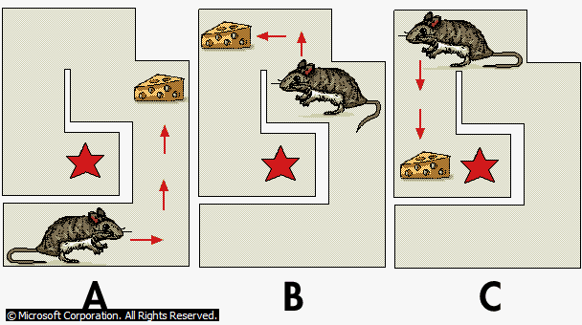
…
Skinner’s process of Successive approximation and Shaping behavior by means of reinforcement and punishment.

Slide 23
Application of the behavioral learning theories
Conditioning study behavior
Conditioning and classroom behavior
Managing Problem Behavior
Dealing with anxieties through conditioning
Conditioning group behavior
Conditioning and Cognitive Processes
Shaping Complex Behavior

Slide 24
2. Social Learning Theory (Observational learning)
According to Bandura, human learning consists of observational learning, which is learning by watching the behavior of another person, or model. It is also called a social cognitive learning.
Bandura identifies three forms of reinforcement that can encourage observational learning. First, the observer may reproduce the behaviors of the model and receive direct reinforcement.
Second, the reinforcement need not be direct - it may be vicarious reinforcement as well. The observer may see others reinforced for a particular behavior and increase his production.
The final form of reinforcement is self-reinforcement, or controlling your reinforcers. In this sort of reinforcement the learner does not get external rewards but the students value and enjoy their growing competence.

Slide 25
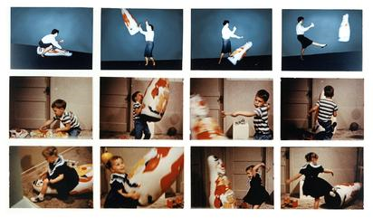
Bandura’s Bobo Doll Experiment

Slide 26
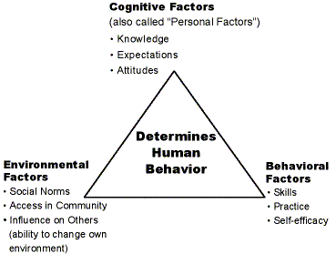
Bandura’s Social Cognitive Theory of Learning
B

Slide 27
…
Social cognitive theorists believe that in human beings, observational learning cannot be fully understood without taking into account the thought processes of the learner.
Bandura mentions four conditions that are necessary before an individual can successfully model the behavior of someone else: 1. Attention: the person must first pay attention to the model.
2. Retention: remembering the behavior observed. 3. Motor reproduction: replicating the action.
4. Motivation: learners need a motivating factor to demonstrate what they have learned.

Slide 28
Implications of Social Learning Theory
1. Students often learn simply by observing other people.
2. Describing the consequences of behavior involve discussing with learners about the rewards and consequences of actions
3. Modeling provides an alternative to shaping. Instead of using shaping, it can provide a faster, more efficient means for teaching new behavior through the four essential conditions; attention, retention, motor reproduction, and motivation.
4. Teachers and parents must model appropriate behaviors and take care that they do not model inappropriate behaviors.
5. Teachers should expose students to a variety of other models.
6. Students must develop self-efficacy to accomplish school tasks.
7.Teachers should help students set realistic expectations for their academic accomplishments.
8. Self-regulation techniques provide an effective method for improving student behavior.

Slide 29
3. Cognitive Learning Theory
Cognition refers to all the mental activities related with thinking, and knowing, activities which include perception and memory.
In both CC&OC, the emphasis was on observable responses. However, because the knowledge that is inside people’s head is not observable, it was not seriously considered.
The emphasis on cognitive approach to learning is on the acquisition of information through interaction; not via R-S or S-R association and the ways of dealing with information.

Slide 30
.
Both classical and operant conditionings have traditionally been explained by the principle of contiguity i.e. the close association of events in time and space.
Contiguity has been used to explain the association of a CS and UCS in classical conditioning and the association of a behavior and its consequences in operant conditioning.
In cognitive learning, learning occurs in the mind independent of any clearly defined association/consequence. It may take two forms: 1. Latent learning 2. Insight learning (gestalt learning or perceptual learning)
For half a century, most American learning theories held that learning could be explained by specifying the behavioral ―ABCs – Antecedents (events preceding behavior), Behaviors, and Consequences

Slide 31
…
Latent Learning
Latent learning is defined as learning that occurs in the absence of any obvious reinforcement or noticeable behavioral changes.
Learning is said to be “latent,” or hidden, because it is not exhibited unless a reinforcement/condition of some kind is introduced to reveal it.
In a classic experiment, Tolman and Honzic (1930) placed three rats in mazes and observed their behavior each day for more than two weeks.
‘Rat-A’ always found food at the end of the maze. ‘Rat-B’ never found food. ‘Rat-C’ found no food for ten days but then received food on the eleventh.

Slide 32
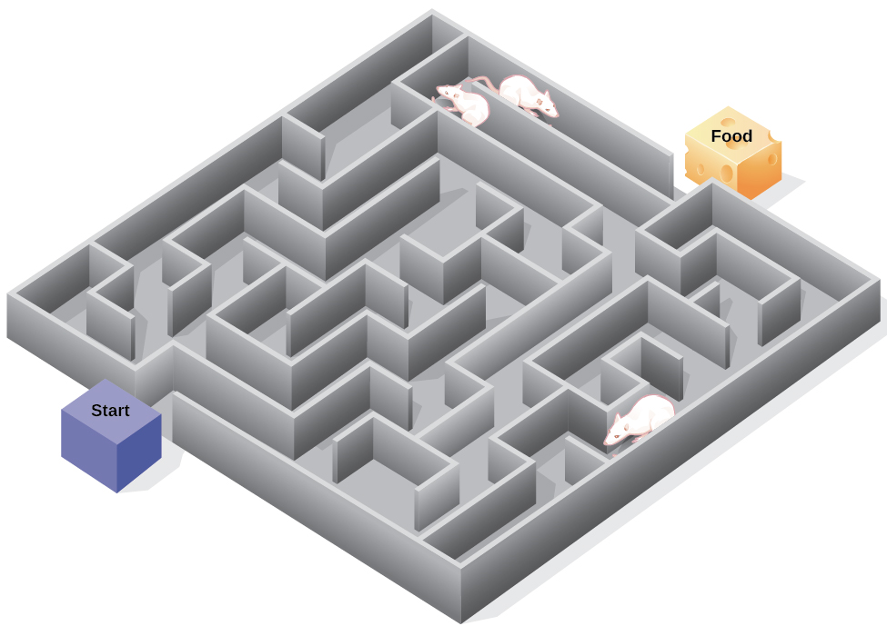
Tolman’s Experiment

Slide 33
…
‘Rat-A’ quickly learned to head straight to the end of the maze without going blind alleys, whereas ‘Rat-B’ did not learn to go to the end.
But, Rat-C was different. For ten days it appeared to follow no particular route. Then, on the eleventh day it quickly learned to run to the end of the maze. By the next day, Rat-C did the same, like Rat-A which had been rewarded from the beginning.
Rat-C had demonstrated latent learning, learning that is not immediately expressed. A great deal of human learning also remains latent until circumstances allow or require it to be expressed.

Slide 34
…
Insight Learning It is a cognitive process whereby we reorganize our perception of a problem. It doesn’t depend on conditioning of particular behaviors for its occurrence. Sometimes, for example, people even wake up from sleep with a solution to a problem that they had not been able to solve during the day.
In a typical insight situation where a problem is posed, a period follows during which no apparent progress is made, and then the solution comes suddenly.
What has been learned in insight learning can also be applied easily to other similar situations.
Human beings who solve a problem insightfully usually experience a good feeling called an 'aha' experience.

Slide 35
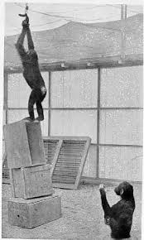
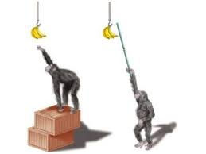
Kohler’s insight Experiment on Chimps

